Slide 1


Is Air Travel safe?
Madhavi Ghanta
Notes:
Hello everyone, this is the final video presentation for DSC 640 course of Bellevue University. In this video, we are going to see why air travel is safe. There has been a lot of chatter in the media regarding the airline crashes and fatalities that occurred, making air travel to be risky compared to other modes of transportation. Should you really worry about travelling in airplane? Let's look at the data before drawing to a conclusion.

Slide 2
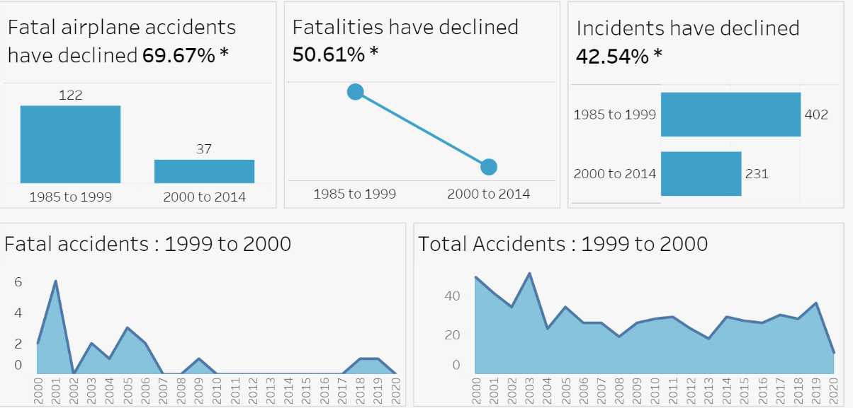
Air travel Statistics
Notes:
when I pull the statistics of air travel data from 1985 to 2014, till 2020, as you see on the screen, the Fatal airplane accidents from 1985 to 1999, there were 122 reported, whereas in 2000 to 2014, 37 were reported. So as you see over the years, there are a lot of improvements and safety measures that came into the picture and are adopted by the airline industries. So that's the reason you see the accidents are declined by 69%. Similarly, for the fatalities as well there is a significant drop, that is by 50%. And even though it could be small incidents, or delays, that also has declined by 42%.So considering statistics. It gives me an initial understanding that air, air travel is still the safest.

Slide 3
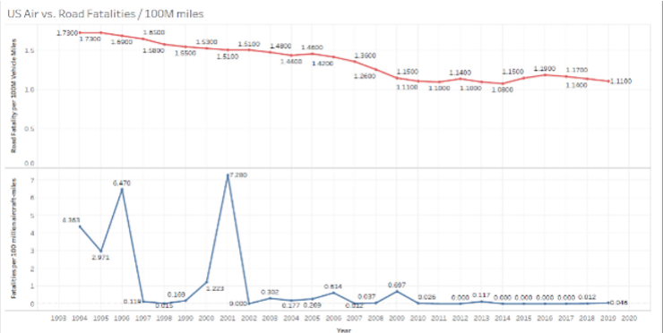
Air vs Ground Fatalities in Last 30 Years
in 2020 we have approx. 1.11 ground fatality VS 0.04 Air fatality per 100 Million travel miles.
Notes:
Let's compare the air travel data with ground transportation and see how air travel is doing. So as you see the line chart on the screen, the top portion of the chart is talking about the ground fatalities and the bottom part of the chart, talks about the air fatalities. So if I take 2020 as an example, we have approximately 1.11 per hundred million travel miles for the ground fatality. Whereas for air, you only see 0.04. So from this, we still can see that the fatalities on airline or air travel is much less compared to ground travel.

Slide 4
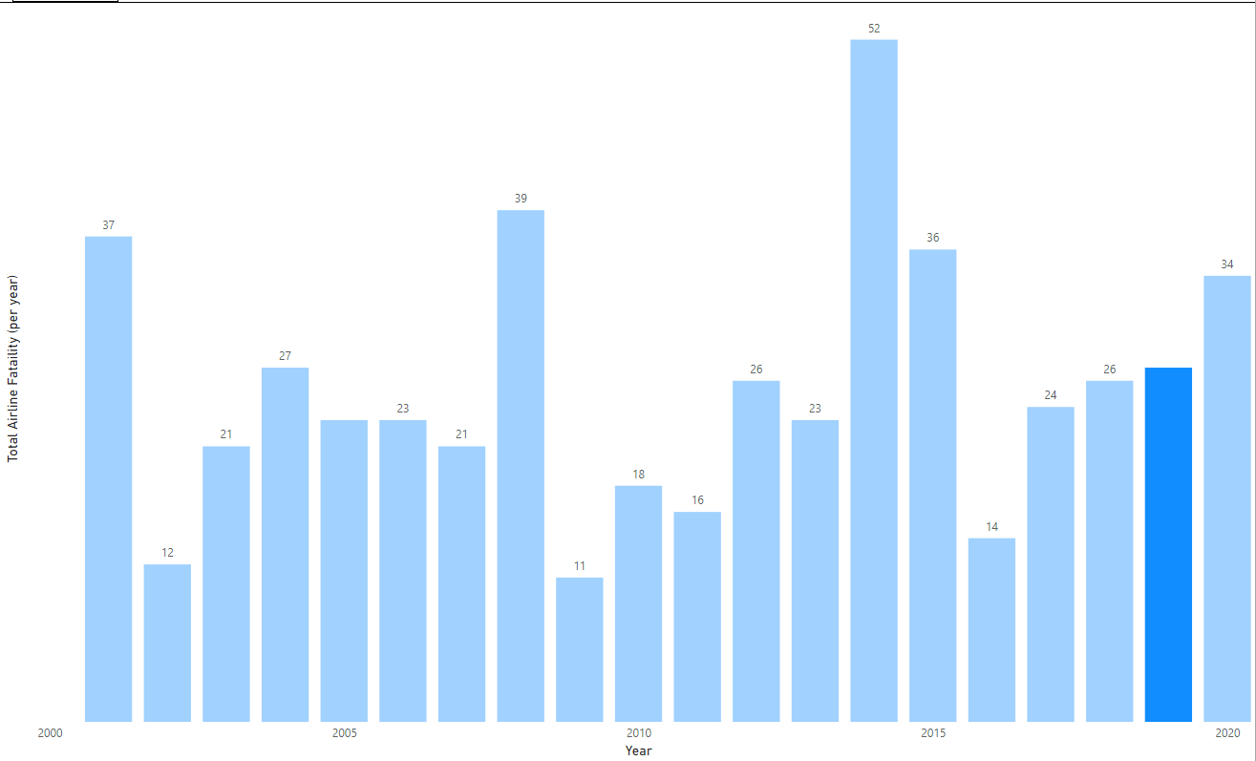
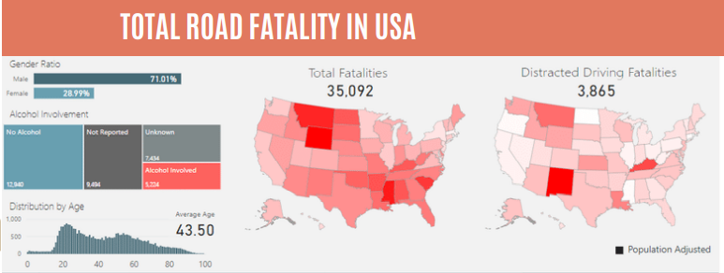
Air vs Ground Fatalities in Last 30 Years
Total Air Fatality in 2019 is 24
Vs
Total Road Fatality in the USA is 35092.
Notes:
Total air fatality in 2019, is 24, and total road fatality in U. S. is around 35. 092. So based on this chart as well, we can clearly say that air travel is still safest.

Slide 5
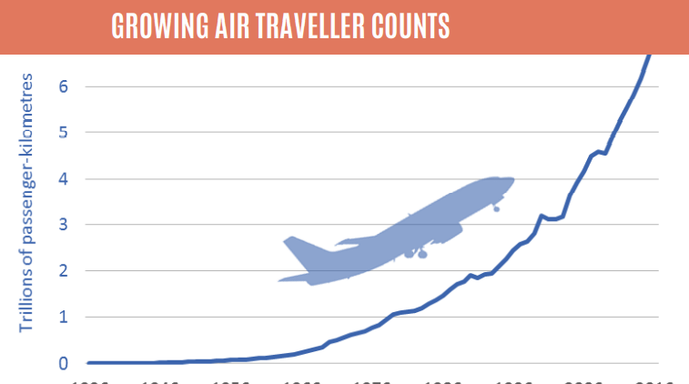
Growing Air travel Counts
Notes:
After considering all these facts, do you still think air travel is unsafe? If air travel is considered to be dangerous as media publishes, let's check the number of passengers that travel by air per year.The number of passengers doing air travel is growing exponentially over the years

Slide 6
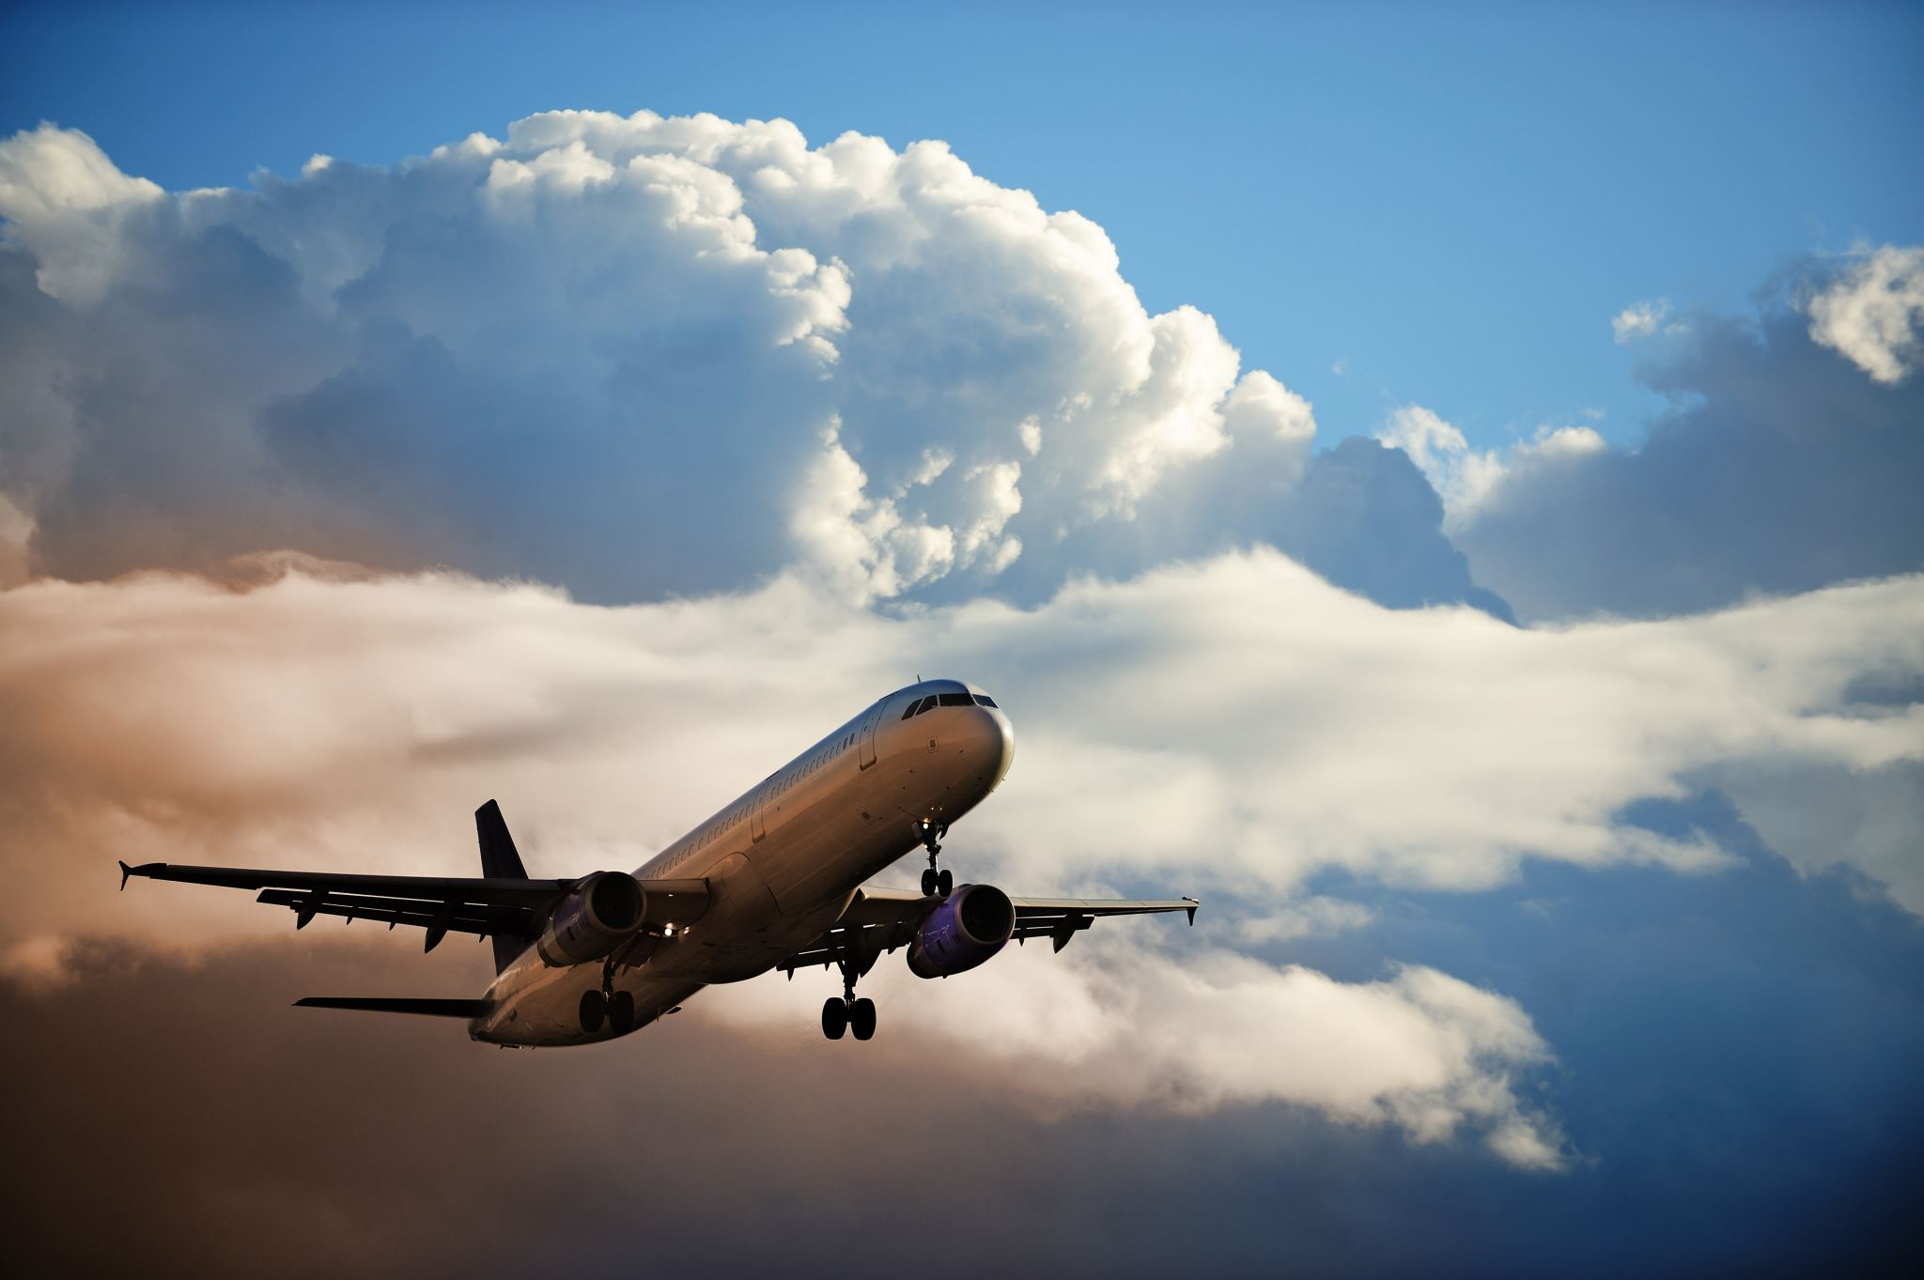
Conclusion
Air travel has become increasingly safer as compared to ground modes of transport. During the last two decades, several safety measures have been adopted by the airline industry, and it has resulted in a decrease the air fatality rates over the decades and not impacted by the exponential increase in air travel schedule and air travel miles.
Notes:
So, I would like to conclude that media is propagating the false propaganda that air travel is exceptionally dangerous after a few recent incidents. During the last two decades, several safety measures have been adopted by the airline industries. And it has resulted in decreasing air fatality rates over the decades. However, it's clear that air travel is much safer mode of transportation. Thanks for watching my video.

